Slide 1
Understanding the Mechanics of Rayleigh Waves
..to make sense of my glacial dataset

Slide 2
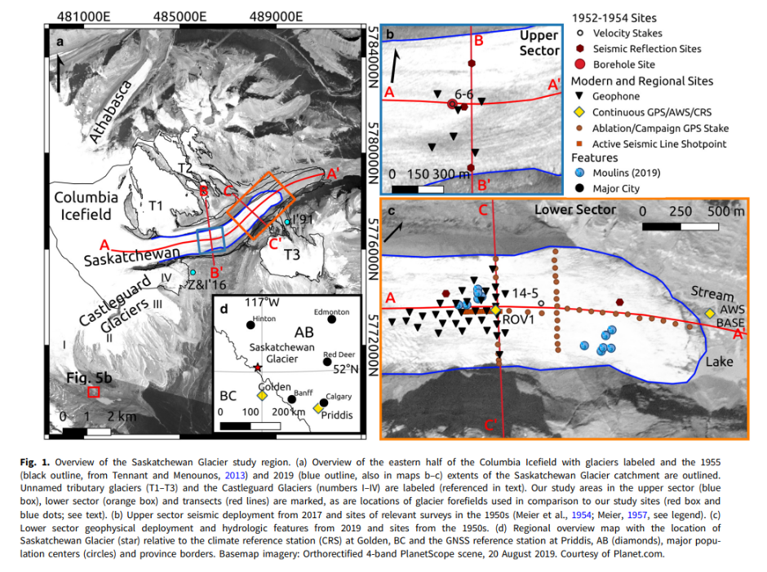


Slide 3
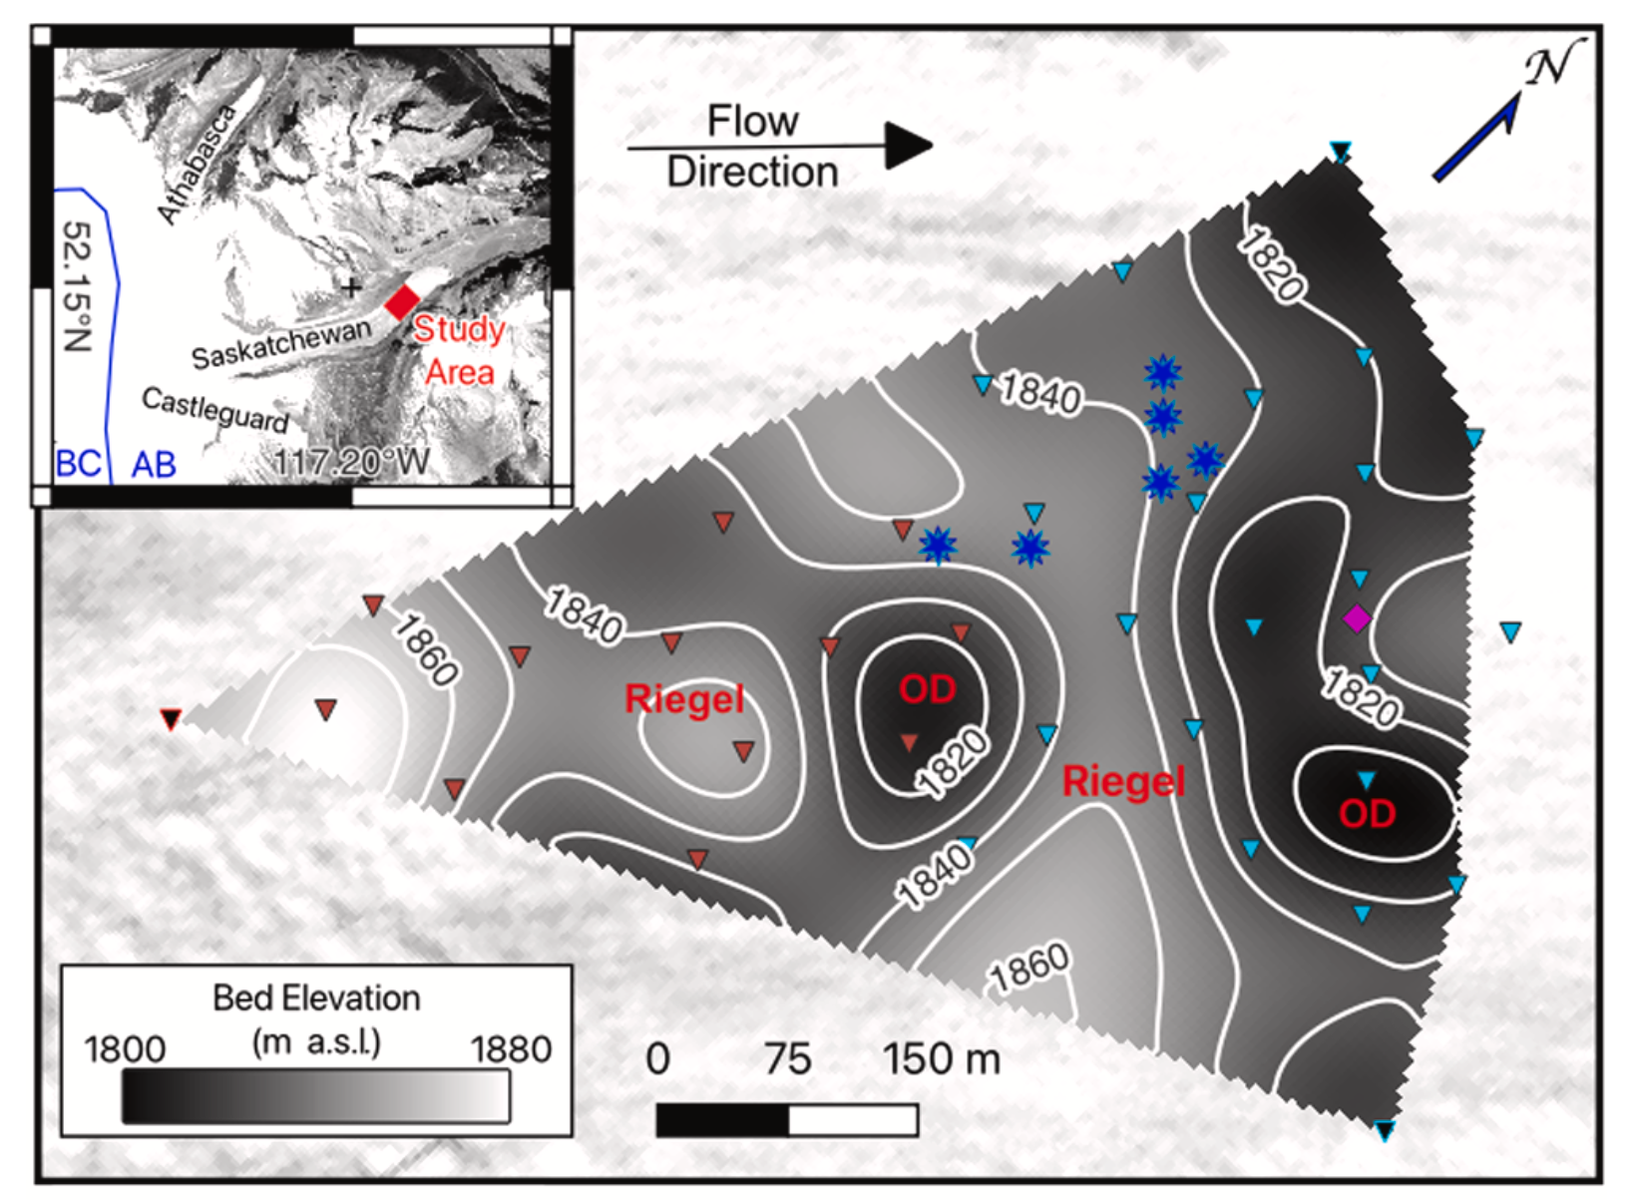
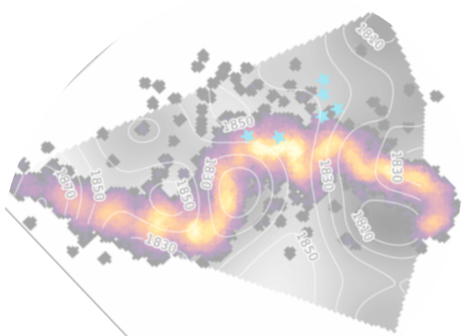
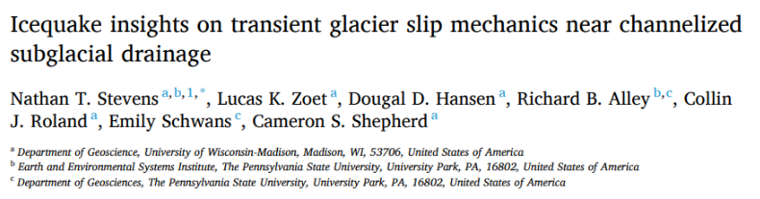

Slide 4
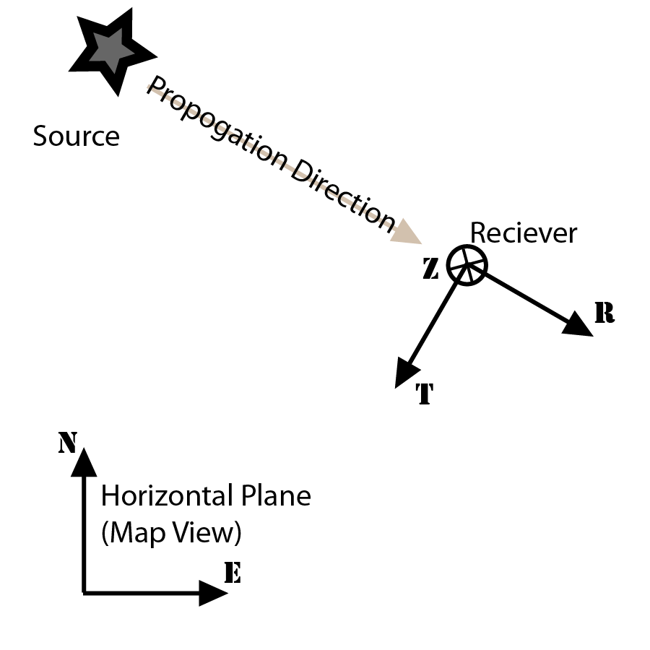
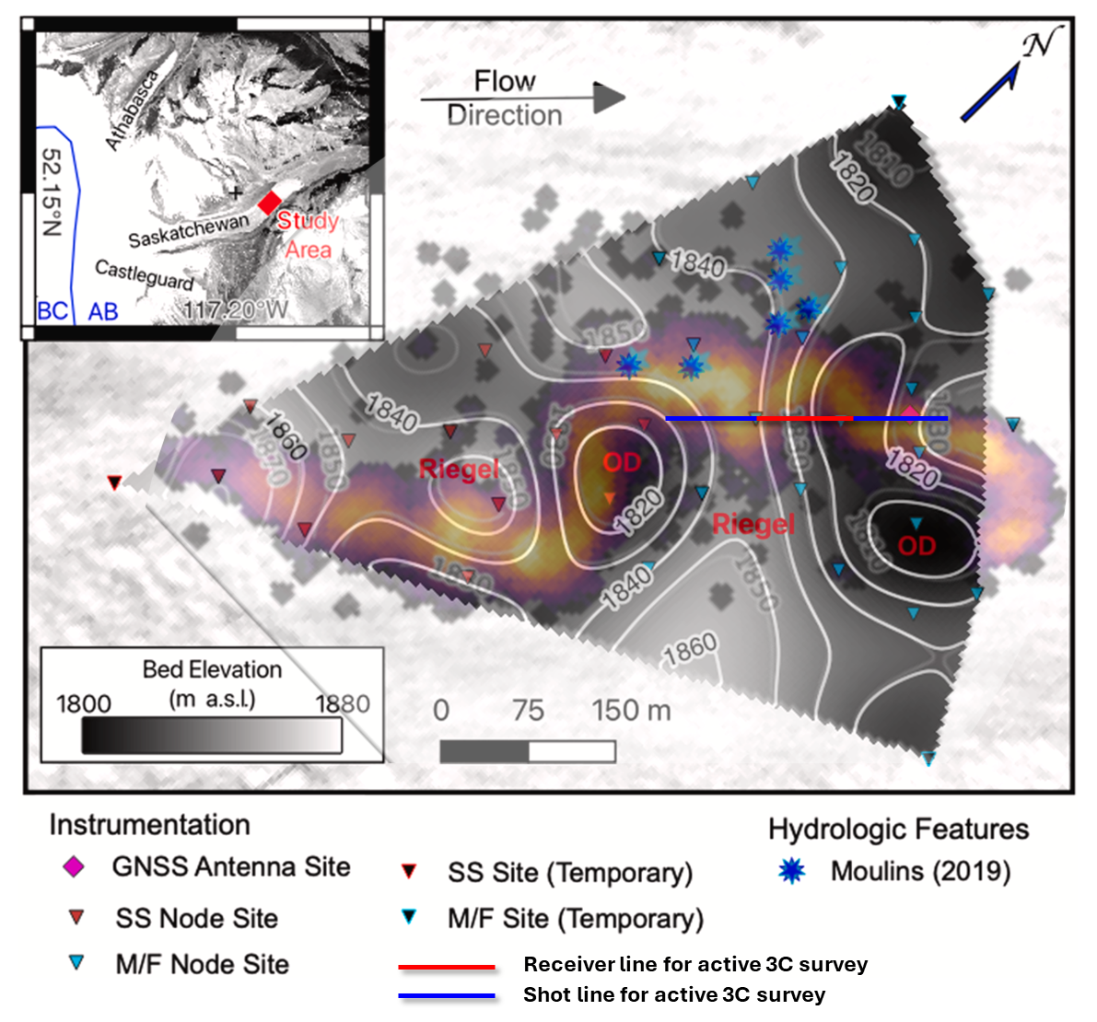
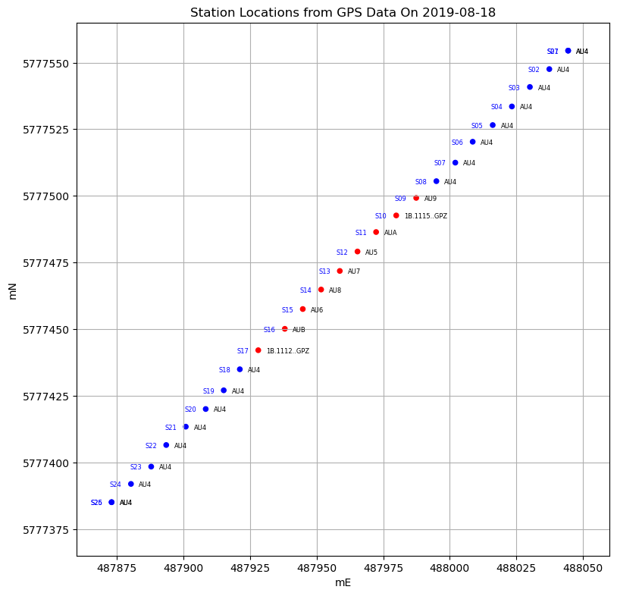
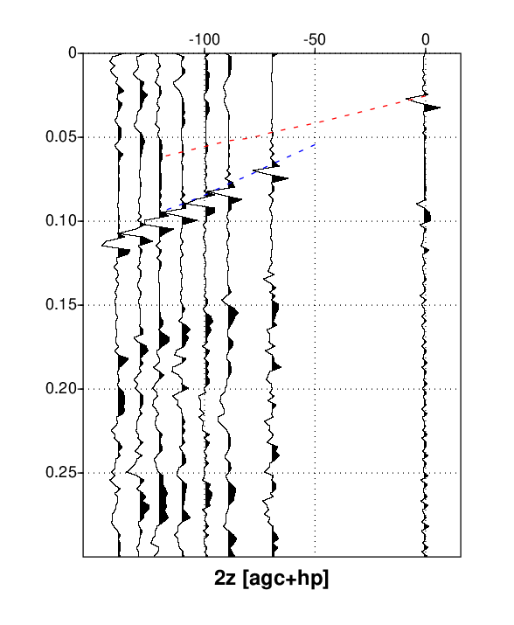
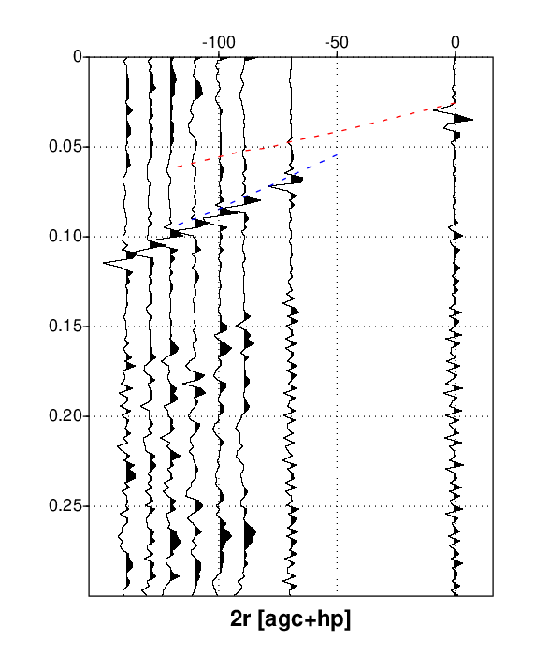
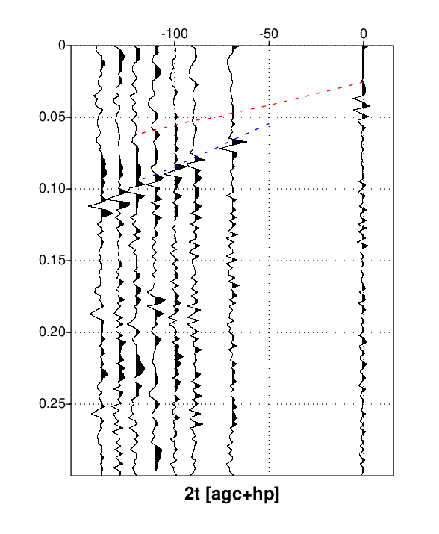
Empirical estimates used in glacial seismology:
Vp/Vs ~ 1.95
Vr/Vs ~ 0.93
Vp/Vr ~ 2.1
Shot 2
3346 m/s
1722 m/s
Time (seconds)
Time (seconds)
Time (seconds)

Slide 5
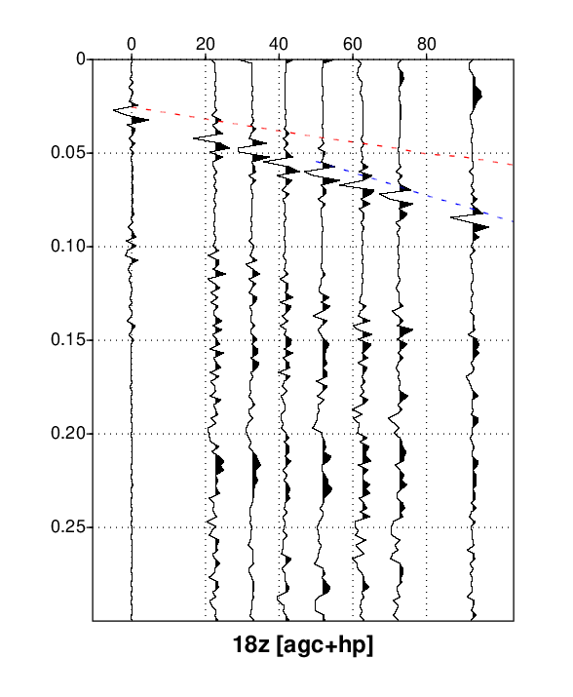
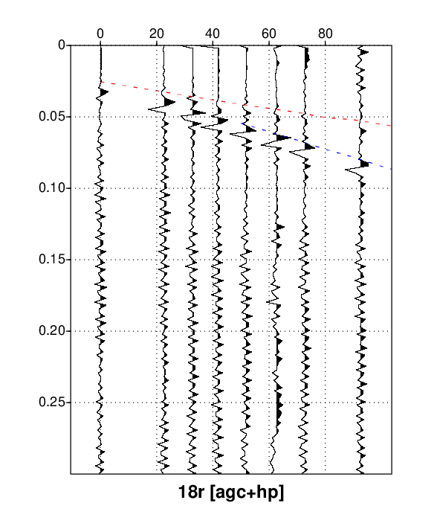
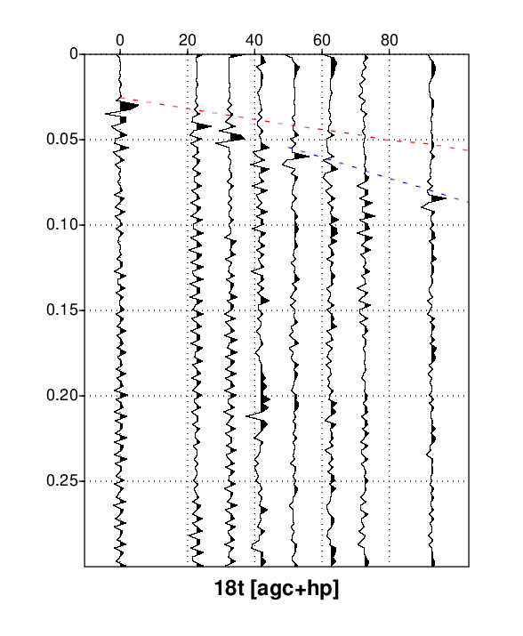
Empirical estimates used in glacial seismology:
Vp/Vs ~ 1.95
Vr/Vs ~ 0.93
Vp/Vr ~ 2.1
Shot 18
Time (seconds)

Slide 6
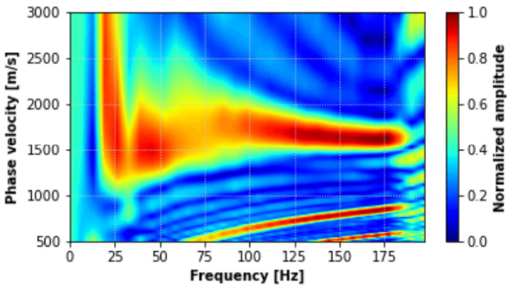
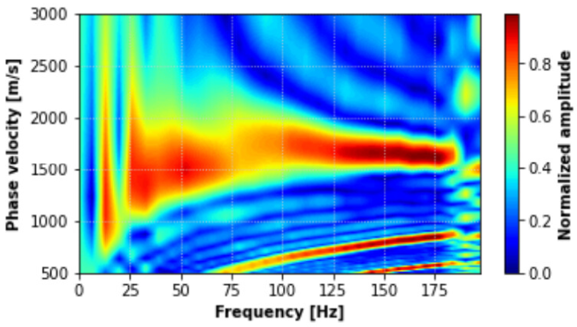
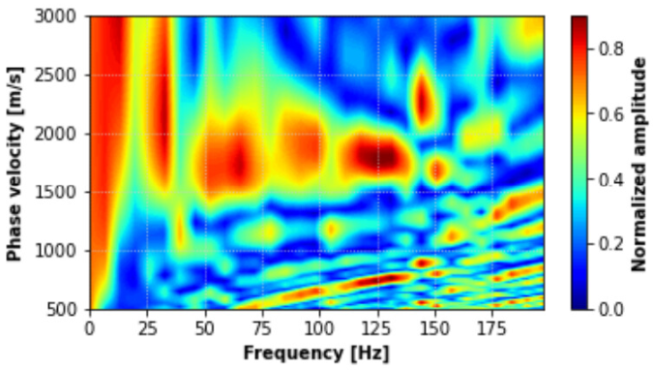
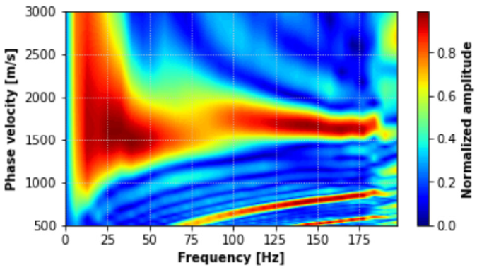
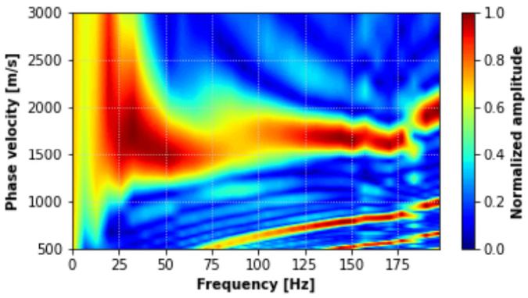
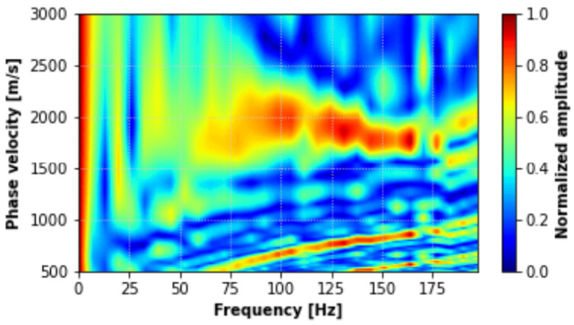
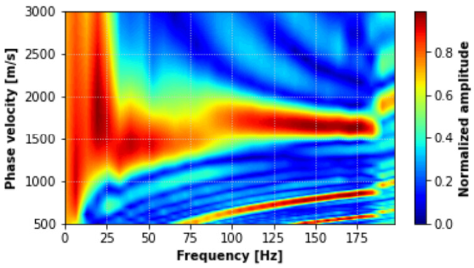
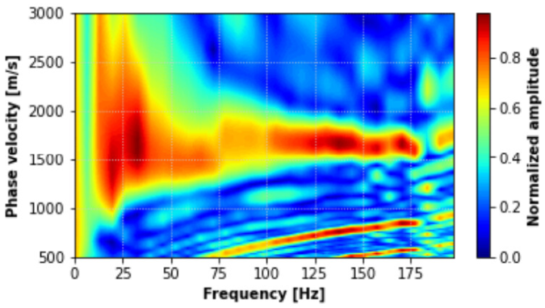
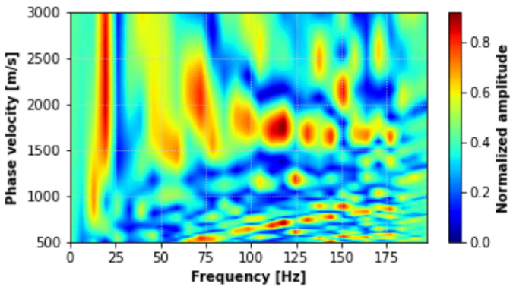
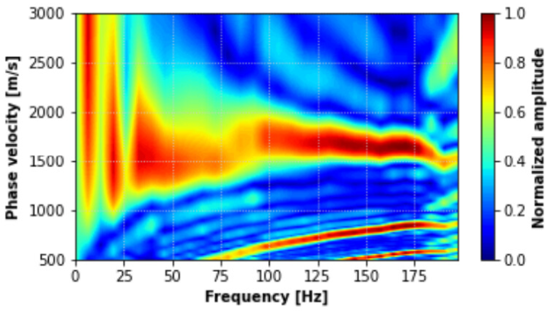
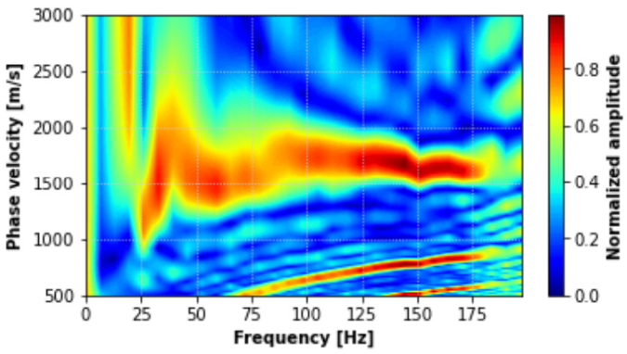
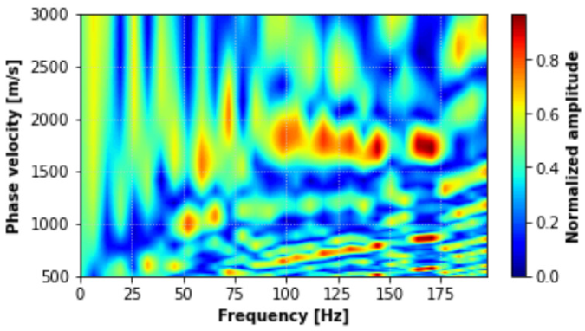
Z
R
T
S02
S08
*no data conditioning prior to building curves
S18
S25

Slide 7
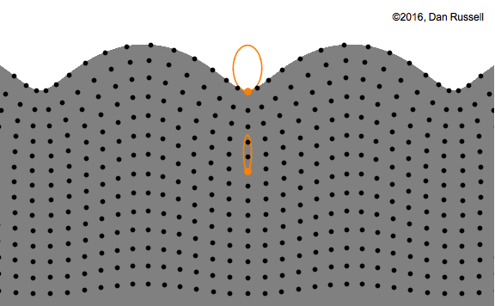
Characteristics of a Rayleigh Wave
Particle Motion
Elliptical – combination of P and SV energy
Retrograde in shallow particle motion
Forward/Clockwise at depth > 1/5th wavelength
Amplitudes
Decay in depth
Geometric spreading (1/r) less than body waves (1/r^2)
Velocity
Slower than S waves
Dispersion – different frequencies travel at different velocities
How do they form?

Slide 8
Ta-da!
Rayleigh wave
Free surface
Energy coming from somewhere

Slide 9
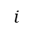
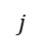
In a perfectly 2-D elastic world, two kinds of body waves could propagate up to the free surface…
Free surface
$$i$$
$$i$$
P-wave
incident
SV-wave
reflected
P-wave
reflected
Free surface
P-wave
reflected
$$j$$
$$j$$
SV-wave
incident
SV-wave
reflected

Slide 10
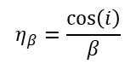
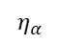
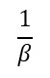
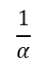
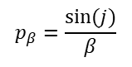
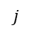
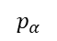
Free surface
$$\frac{1}{α}$$
$$η_{α}$$
$$\frac{1}{β}$$
$$p_{α}$$
P-wave
reflected
$$j$$
$$j$$
$$η_{β}=\frac{\cos\left(i\right)}{β}$$
$$p_{β}=\frac{sin⁡(j)}{β}$$
SV-wave
incident
SV-wave
reflected

Slide 11
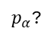
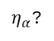

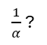
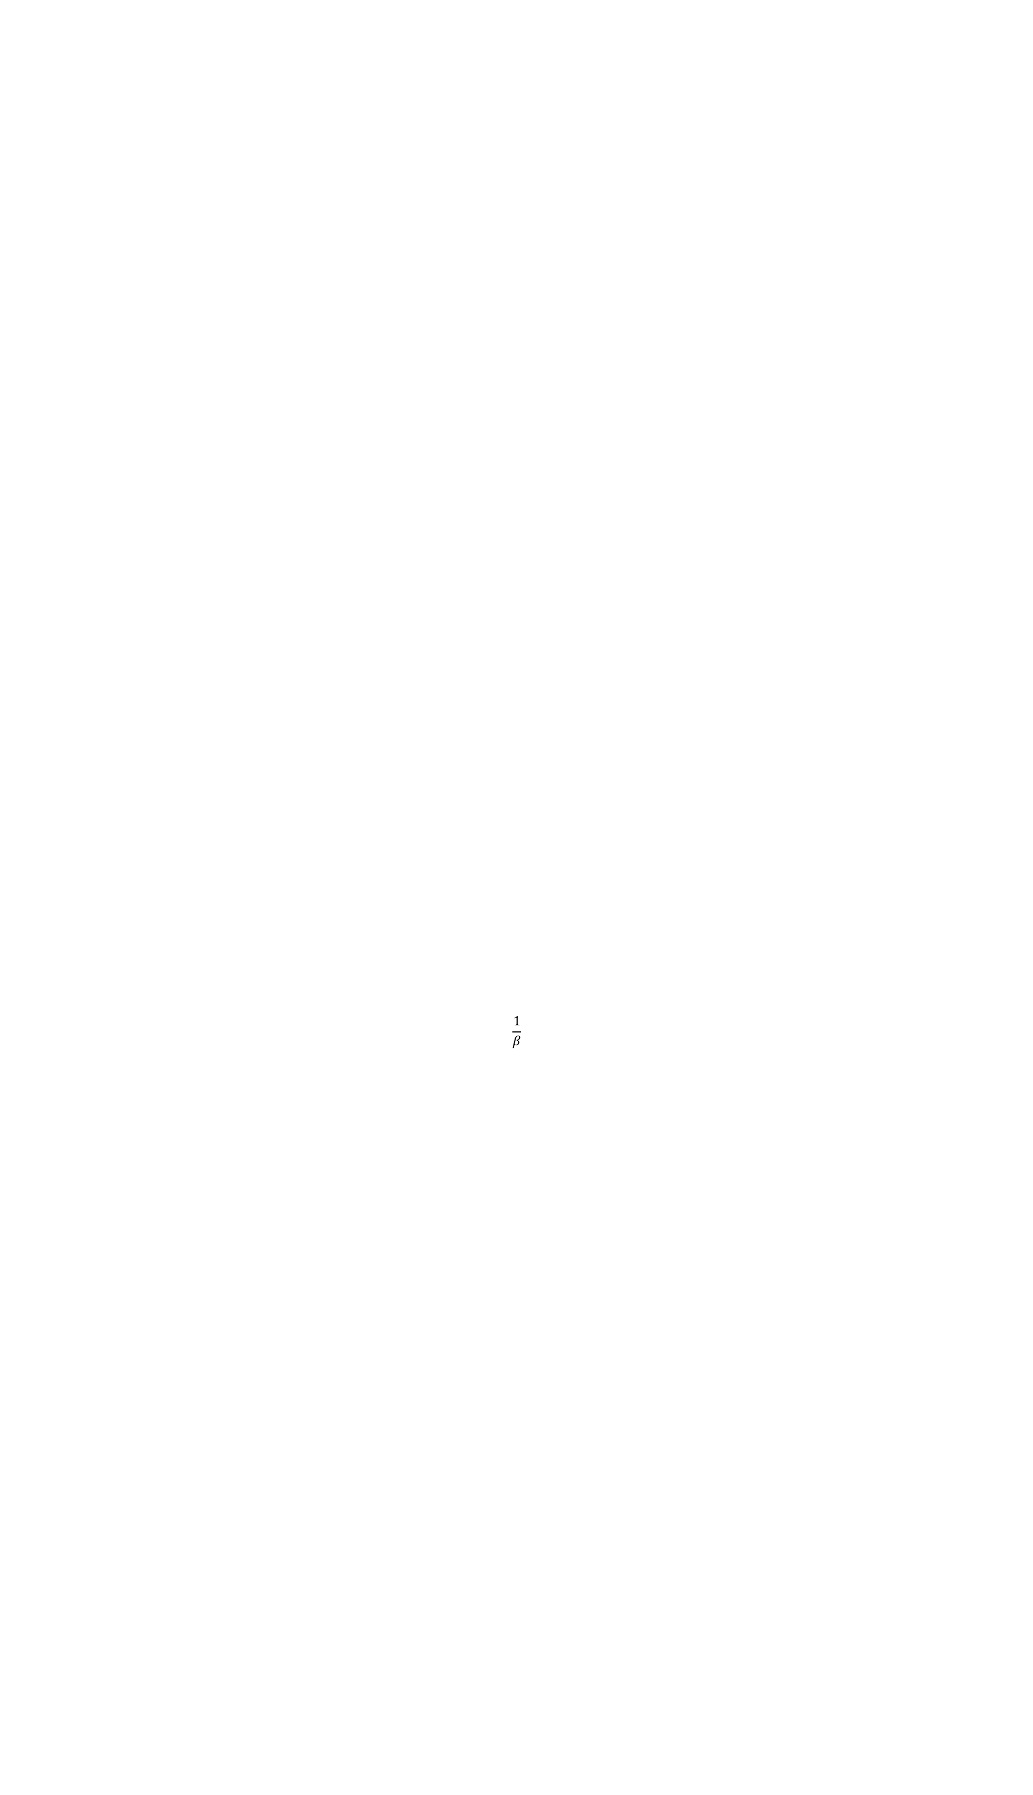
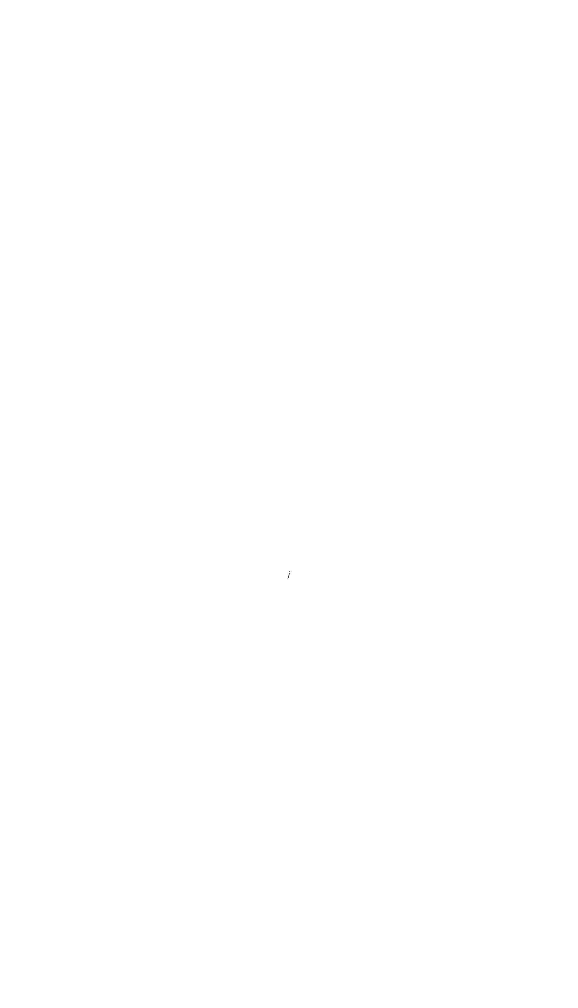

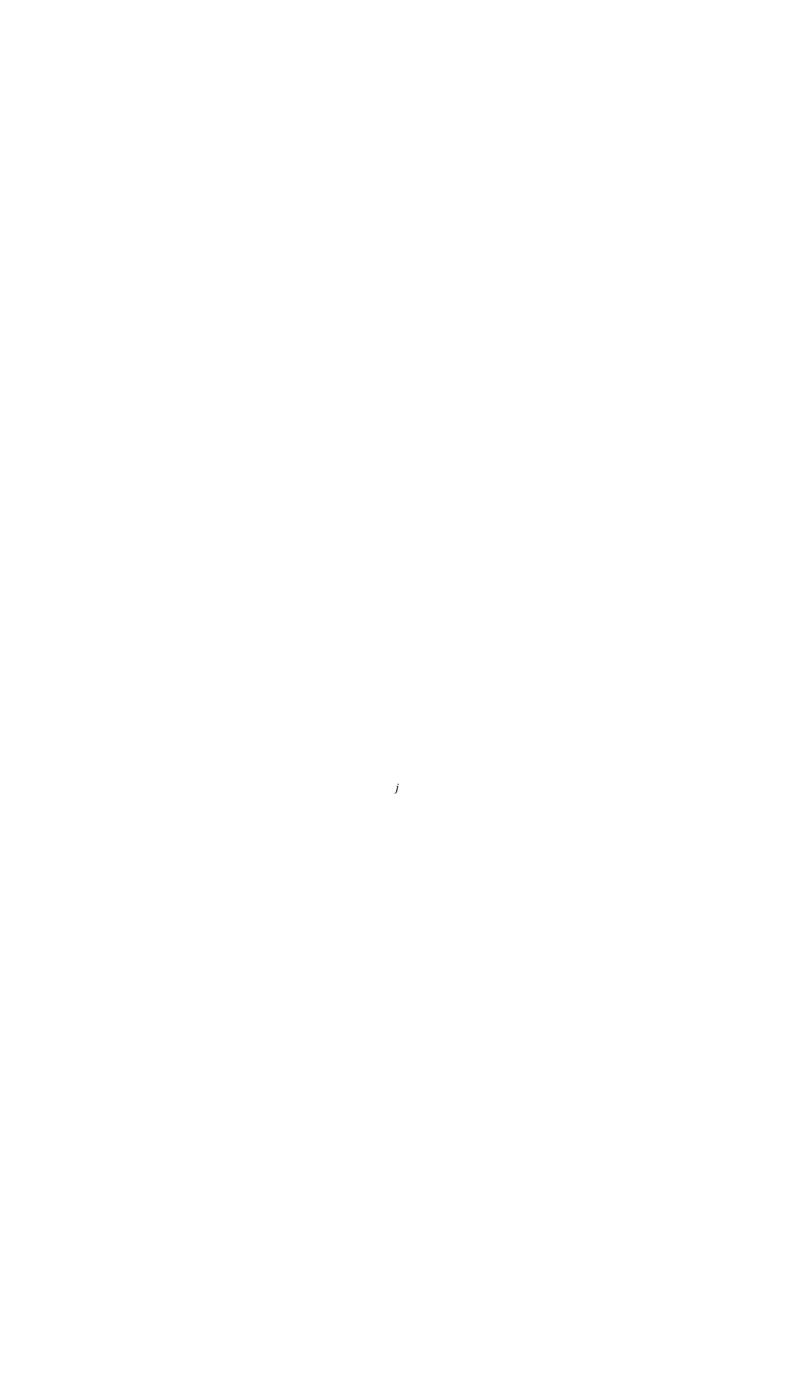

What happens when the incident SV-wave is at (or beyond) the critical angle for the converted P-wave?
Free surface
$p_{α}$?
$\frac{1}{α}$ ?
$η_{α}$?
P-wave…
$$j$$
$$j$$
$$\frac{1}{β}$$
$$η_{β}$$
$$j=j_{c}$$
$$p_{β}$$
SV-wave
reflected
SV-wave
incident

Slide 12
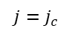
Evanescent P-wave
Acts like a wave, but conveys no power
Magnitude decays exponentially with increasing distance away from interface
Standing wave (can only exist when the incident wave strikes the surface)
Free surface
$$j=j_{c}$$
$$j$$
SV-wave
incident
Post-critically reflected SV-wave
Totally reflected
Phase shifted
The combined result → Rayleigh wave

Slide 13
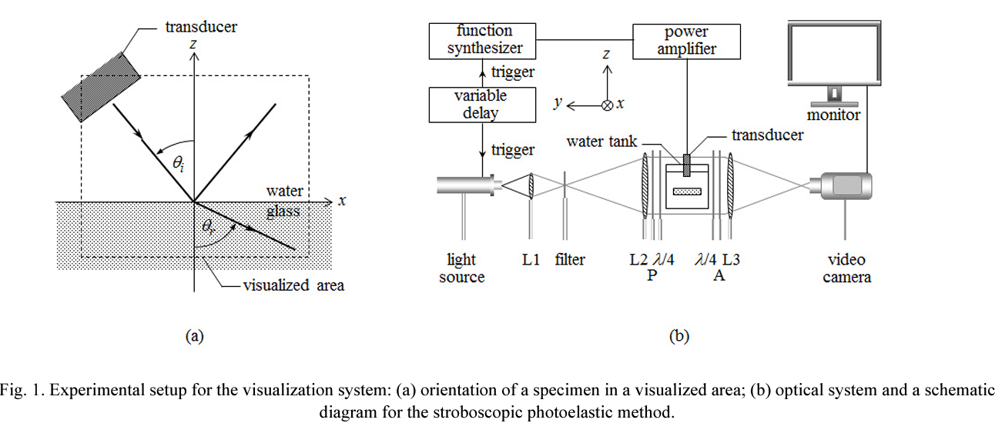
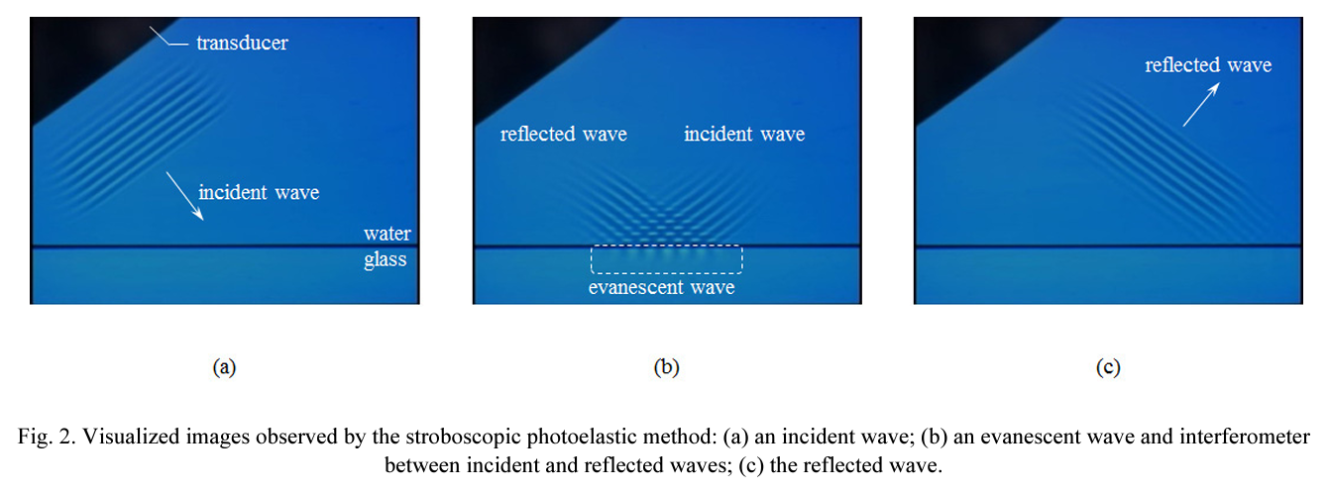
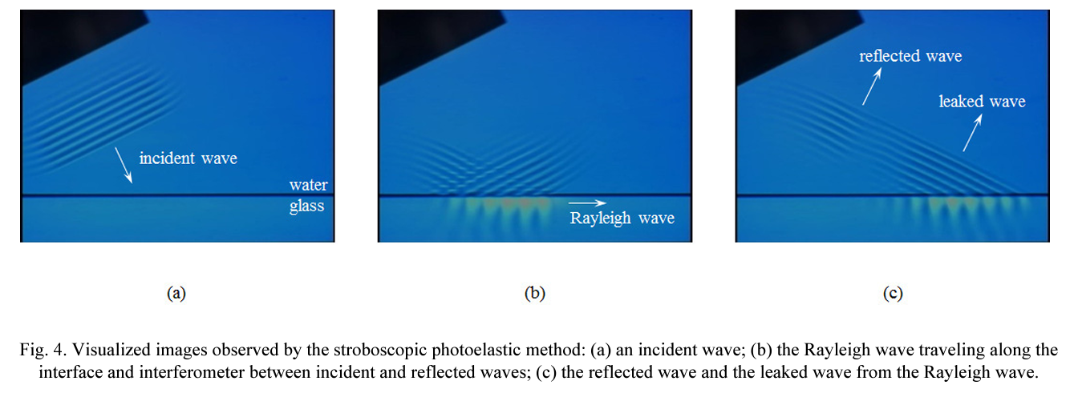
“…acoustic evanescent waves produced when a propagating incident wave impinges on a water/glass interface at a post-critical angle, using the Fresnel method in the water and the photoelastic method in the glass”
Yamamoto, 2015

Slide 14
Characteristics of a Rayleigh Wave
Particle Motion
Elliptical – combination of P and SV energy
Retrograde in shallow particle motion
Forward/Clockwise at depth > 1/5th wavelength
Amplitudes
Decay in depth
Geometric spreading (1/r) less than body waves (1/r^2)
Velocity
Slower than S waves
Dispersion – different frequencies travel at different velocities
NEXT : Making the math make sense… to me

Slide 15
DISCLAIMER:
Too many equations coming up…

Slide 16
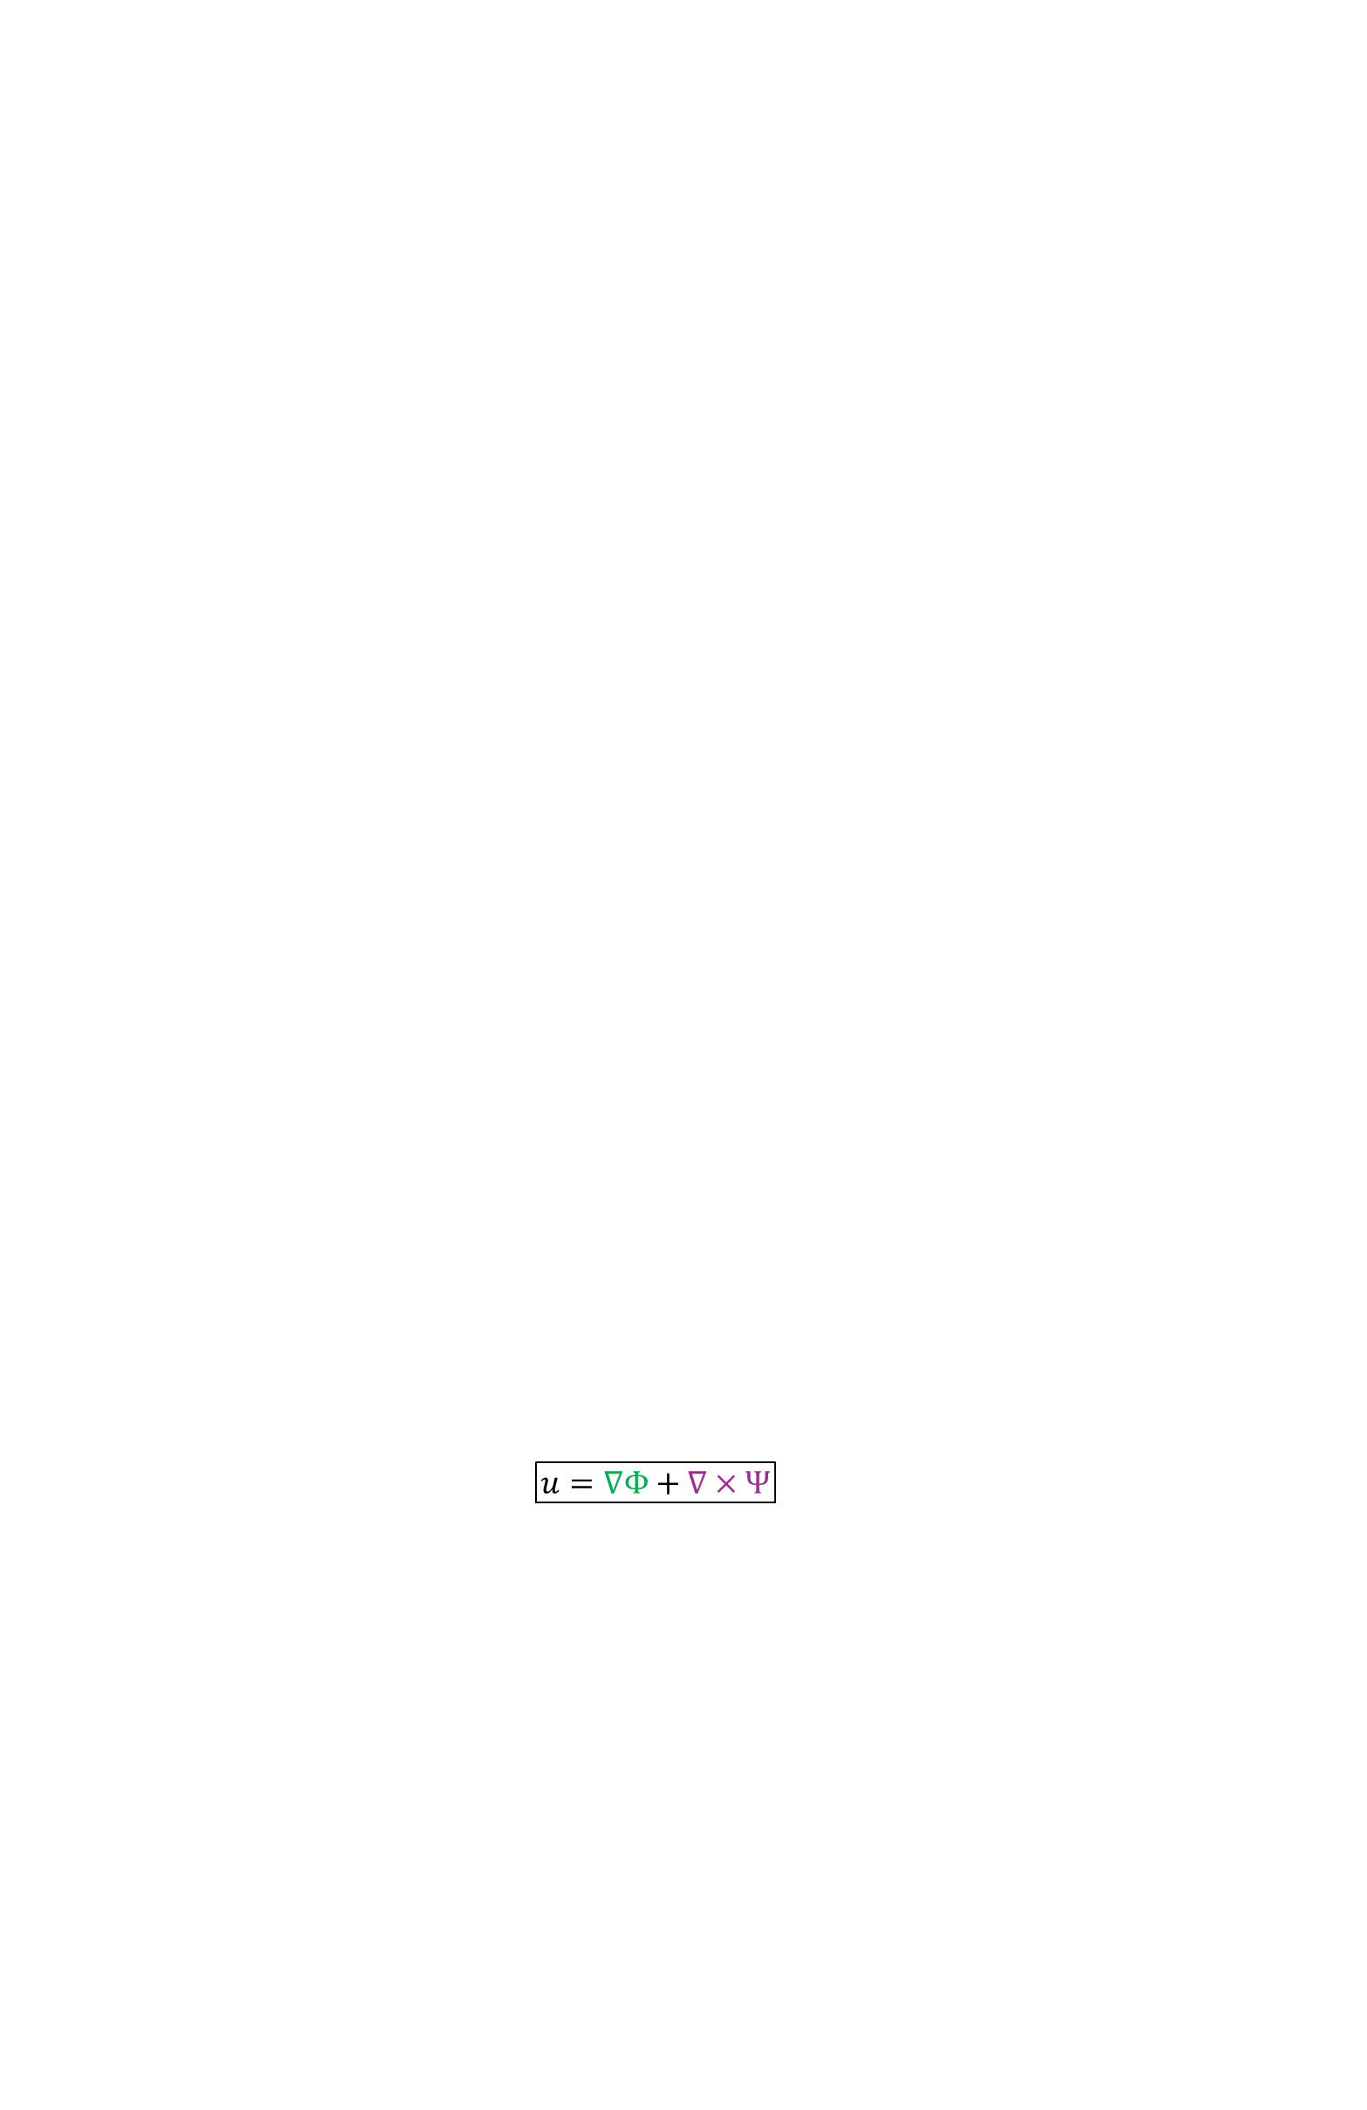

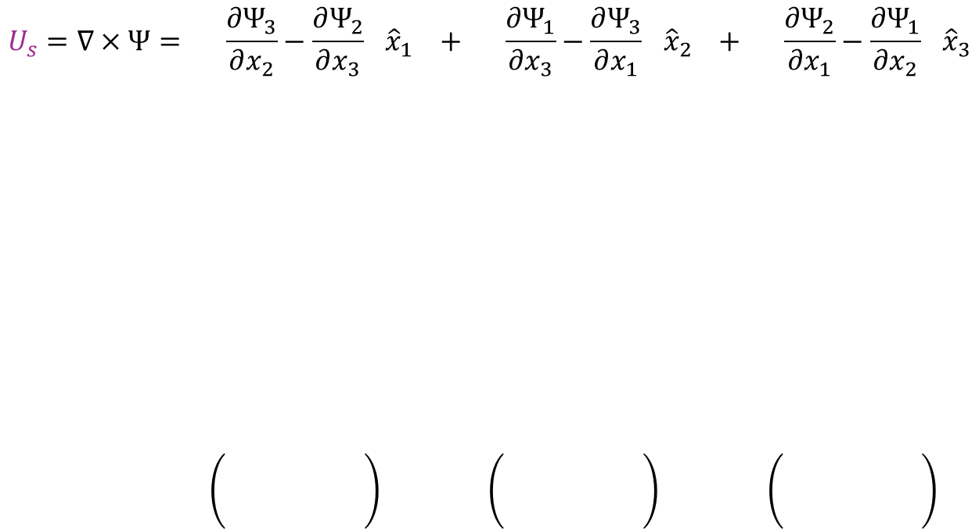
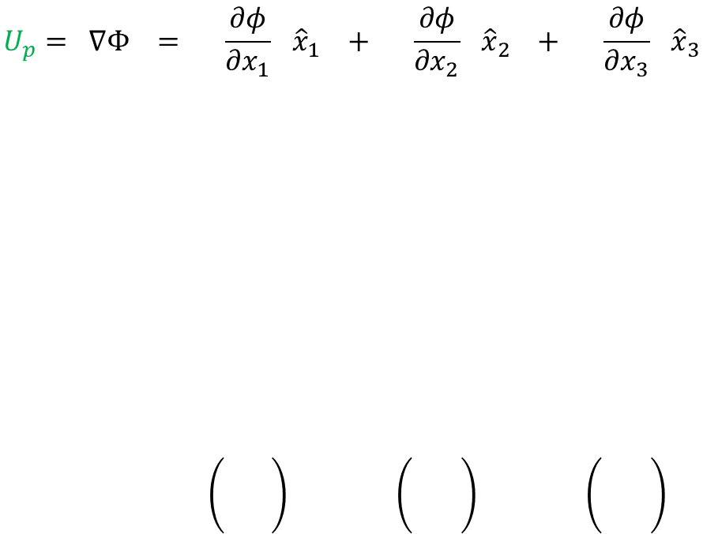
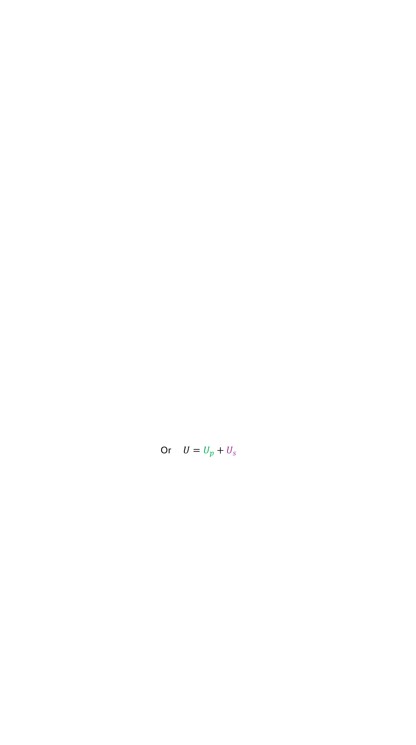
homogeneous equation of motion for isotropic, linearly elastic medium
The start:
$$ρ\ddot{u}=\left(λ+μ\right)∇\left(∇∙u\right)+μ(∇×∇×u)$$
What is u?
$$u=∇Φ+∇×Ψ$$
Potential wavefields
Or $U=U_{p}+U_{s}$
$$U_{p}= ∇Φ = \left(\frac{∂φ}{∂x_{1}}\right){\hat{x}}_{1} + \left(\frac{∂φ}{∂x_{2}}\right){\hat{x}}_{2} + \left(\frac{∂φ}{∂x_{3}}\right){\hat{x}}_{3}$$
1
2
$$U_{s}=∇×Ψ= \left(\frac{∂Ψ_{3}}{∂x_{2}}−\frac{∂Ψ_{2}}{∂x_{3}}\right){\hat{x}}_{1} + \left(\frac{∂Ψ_{1}}{∂x_{3}}−\frac{∂Ψ_{3}}{∂x_{1}}\right){\hat{x}}_{2} + \left(\frac{∂Ψ_{2}}{∂x_{1}}−\frac{∂Ψ_{1}}{∂x_{2}}\right){\hat{x}}_{3}$$
3

Slide 17
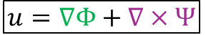




homogeneous equation of motion for isotropic, linearly elastic medium
The start:
$$ρ\ddot{u}=\left(λ+μ\right)∇\left(∇∙u\right)+μ(∇×∇×u)$$
What is u?
$$u=∇Φ+∇×Ψ$$
Potential wavefields
Or $U=U_{p}+U_{s}$
Simplify algebra:
Wave propagation only in the $x_{1}x_{3}$ plane
There is no change in wavefield in the $x_{2}$ direction
1
3
$$\frac{∂Φ}{∂x_{2}}or\frac{∂Ψ}{∂x_{2}}=0$$

Slide 18

homogeneous equation of motion for isotropic, linearly elastic medium
The start:
$$ρ\ddot{u}=\left(λ+μ\right)∇\left(∇∙u\right)+μ(∇×∇×u)$$
What is u?
$$u=∇Φ+∇×Ψ$$
Potential wavefields
Or $U=U_{p}+U_{s}$
$$U_{p}= ∇Φ = \left(\frac{∂φ}{∂x_{1}}\right){\hat{x}}_{1} + \left(\frac{∂φ}{∂x_{2}}\right){\hat{x}}_{2} + \left(\frac{∂φ}{∂x_{3}}\right){\hat{x}}_{3}$$
1
$$U_{s}=∇×Ψ= \left(\frac{∂Ψ_{3}}{∂x_{2}}−\frac{∂Ψ_{2}}{∂x_{3}}\right){\hat{x}}_{1} + \left(\frac{∂Ψ_{1}}{∂x_{3}}−\frac{∂Ψ_{3}}{∂x_{1}}\right){\hat{x}}_{2} + \left(\frac{∂Ψ_{2}}{∂x_{1}}−\frac{∂Ψ_{1}}{∂x_{2}}\right){\hat{x}}_{3}$$
3

Slide 19



homogeneous equation of motion for isotropic, linearly elastic medium
The start:
$$ρ\ddot{u}=\left(λ+μ\right)∇\left(∇∙u\right)+μ(∇×∇×u)$$
What is u?
$$u=∇Φ+∇×Ψ$$
Potential wavefields
Or $U=U_{p}+U_{s}$
$$U_{SH}$$
1
$$U=U_{p}+U_{s}=\left(\frac{∂Φ}{∂x_{1}}−\frac{∂Ψ_{2}}{∂x_{3}}\right){\hat{x}}_{1}+\left(\frac{∂Ψ_{1}}{∂x_{3}}−\frac{∂Ψ_{3}}{∂x_{1}}\right){\hat{x}}_{2}+\left(\frac{∂Φ}{∂x_{3}}−\frac{∂Ψ_{2}}{∂x_{1}}\right){\hat{x}}_{3}$$
$$U_{SV}$$
2
3
$$U_{P}$$

Slide 20

homogeneous equation of motion for isotropic, linearly elastic medium
The start:
$$ρ\ddot{u}=\left(λ+μ\right)∇\left(∇∙u\right)+μ(∇×∇×u)$$
What is u?
$$u=∇Φ+∇×Ψ$$
Potential wavefields
Or $U=U_{p}+U_{s}$
$$U_{SH}$$
1
$$U=U_{p}+U_{s}=\left(\frac{∂Φ}{∂x_{1}}−\frac{∂Ψ_{2}}{∂x_{3}}\right){\hat{x}}_{1}+\left(\frac{∂Ψ_{1}}{∂x_{3}}−\frac{∂Ψ_{3}}{∂x_{1}}\right){\hat{x}}_{2}+\left(\frac{∂Φ}{∂x_{3}}−\frac{∂Ψ_{2}}{∂x_{1}}\right){\hat{x}}_{3}$$
$$U_{SV}$$
2
3
$$U_{P}$$
Rayleigh wave: P and SV motion

Slide 21







$$ρ\ddot{u}=\left(λ+μ\right)∇\left(∇∙u\right)+μ(∇×∇×u)$$
$$u=∇Φ+∇×Ψ$$
Sprinkle some vector identities…
Scalar wave equation:
$$∇^{2}Φ−\frac{1}{α^{2}}\ddot{Φ}=0$$
What are the potentials $Φ$ and $Ψ$?
Vector wave equation:
$$∇^{2}Ψ−\frac{1}{β^{2}}\ddot{Ψ}=0$$
Wavefields which can be represented by harmonic plane wave solutions
From separation of variables solution, we assume the solution to each potential has a form that separates spatial and temporal dependance
$$u_{i}=X\left(x_{i}\right) T(t)$$
With substitutions and some math, this sets up a solution for displacement as a sum of simple harmonic waves
$$u=Ae^{iω\left(t±\frac{x}{c}\right)}=Acos\left[ω\left(t±\frac{x}{c}\right)\right]+iAsin\left[ω\left(t±\frac{x}{c}\right)\right]$$

Slide 22










$$Ψ_{I}=Ie^{iω(px_{1}−η_{β}x_{3}−t)}$$
$$j$$
$$j$$
$$\frac{1}{a}$$
$$η_{α}=\frac{\cos\left(i\right)}{α}$$
$$i$$
$$Ψ_{R}=R_{s}e^{iω(px_{1}+η_{β}x_{3}−t)}$$
$$p=\frac{sin⁡(i)}{a}$$
$$j$$
$$j$$
$$η_{β}=\frac{\cos\left(i\right)}{β}$$
$$Φ_{R}=R_{p}e^{iω(px_{1}+η_{α}x_{3}−t)}$$
$$i$$
$$\frac{1}{β}$$
$$p=\frac{sin⁡(i)}{β}$$

Slide 23









$$η_{α}=\sqrt{\frac{1}{α^{2}}−p^{2}} is imaginary since p>\frac{1}{a}$$
Evanescent
P-wave
Evanescent
SV-wave
$$η_{α}=i\hat{η_{α}}=i\sqrt{p^{2}−\frac{1}{α^{2}}}=i\sqrt{\frac{1}{c^{2}}−\frac{1}{α^{2}}}$$
$$η_{a}=imaginary$$
$$η_{β}=imaginary$$
$$p>\frac{1}{a}$$
$$p>\frac{1}{β}$$
$$j$$
$$j$$
Post-critically reflected SV wave grazes surface
creating an evanescent SV wave
$$η_{β}=i\hat{η_{β}}=i\sqrt{p^{2}−\frac{1}{β^{2}}}=i\sqrt{\frac{1}{c^{2}}−\frac{1}{β^{2}}}$$

Slide 24
Evanescent
P-wave
Evanescent
SV-wave
$$Φ_{E}=Ae^{iω(px_{1}+i\hat{η_{α}}x_{3}−t)}=A e^{−ω\hat{η_{α}}x_{3}}{ e}^{iω\left(px_{1}−t\right)}$$
$$η_{a}=imaginary$$
$$η_{β}=imaginary$$
$$p>\frac{1}{a}$$
$$p>\frac{1}{β}$$
$$Ψ_{E}=Be^{iω(px_{1}+i\hat{η_{β}}x_{3}−t)}=B{ e}^{−ω\hat{η_{β}}x_{3}}{ e}^{iω\left(px_{1}−t\right)}$$
$$j$$
$$j$$
Exponential function
Traveling wave
function
So, what is the combined result?! → velocity, displacement, amplitude?
We know that because of the free surface condition …

Slide 25







Free surface condition for homogeneous isotropic elastic media all components of the stress tensor perpendicular to the surface z=0 vanish
$$σ_{ij}=λε_{ij}∂_{ij}+2με_{ij}$$
$$σ_{33}=0 \text{(}\text{no} \text{normal} \text{stress} \text{in} \text{the} \text{z} \text{direction}\text{)}$$
$$τ_{13}=0 \text{(}\text{no} \text{shear} \text{stress} \text{in} \text{the} \text{xz}\text{−}\text{plane}\text{)}$$
$$σ_{33}→ λε_{11}+ λε_{33}+2με_{33}=λ\left(\frac{∂u_{1}}{∂x_{1}}+\frac{∂u_{3}}{∂u_{3}}\right)+2μ\left(\frac{∂u_{3}}{∂x_{3}}\right)=0$$
$$τ_{13}→2με_{13}=2μ\left(\frac{∂u_{1}}{∂x_{3}}\right)=0$$
$$u_{1}=\frac{∂Φ_{E}}{∂x_{1}}−\frac{∂Ψ_{E}}{∂x_{3}}$$
$$u_{3}=\frac{∂Φ_{E}}{∂x_{3}}−\frac{∂Ψ_{E}}{∂x_{1}}$$
$$What are u_{1}and u_{3}in terms of potentials?$$

Slide 26





Can rearrange stresses into P & S contributions:
$$σ_{33}=σ_{zz}^{P}+σ_{zz}^{S}=0$$
$$τ_{13}=τ_{xz}^{P}+τ_{xz}^{S}=0$$
Eigenvalue of Displacement Eigenfunction!
Non-trivial solutions of apparent velocity, c can be found by finding the root where the determinant of the matrix is zero
(note trivial solution would be A = B = 0)
$$\left[\begin{matrix}\left(λ+2μ\right){\hat{η}}_{α}^{2}+λp^{2} & 2μp{\hat{η}}_{β} \\ 2p{\hat{η}}_{α} & p^{2}−{\hat{η}}_{β}^{2} \end{matrix}\right]\left[{A \atop B}\right]=\left[{0 \atop 0}\right]$$
Determinant: ${\left(\frac{1}{β^{2}} −2p^{2}\right)}^{4}−16p^{4}{\hat{η}}_{α}^{2}{\hat{η}}_{β}^{2}=0$
$$\frac{c^{2}}{β^{2}}\left[\frac{c^{6}}{β^{6}}−8\frac{c^{4}}{β^{4}}+\left(24−16\frac{β^{2}}{α^{2}}\right)\frac{c^{2}}{β^{2}}+16\left(\frac{β^{2}}{α^{2}}−1\right)\right]=0$$

Slide 27






Characteristic Equation (homogenous, isotropic)
$$\frac{c^{6}}{β^{6}}−8\frac{c^{4}}{β^{4}}+\left(24−16\frac{β^{2}}{α^{2}}\right)\frac{c^{2}}{β^{2}}+16\left(\frac{β^{2}}{α^{2}}−1\right)=0$$
cubic polynomial in $\frac{c^{2}}{β^{2}}$
No dependence on frequency – everything done to this point assumes a half space
$$if c=0 →16\left(\frac{β^{2}}{α^{2}}−1\right)→negative$$
$$if c=β →−7+\left(24\right)+16\left(−1\right)=1 →positive$$
$$Somewhere in range: 0<c<β→zero/root!$$
$$if c=α →\sqrt{2}→valid ?$$
$$if Poisson Solid i.e.\frac{Vp}{Vs}=\sqrt{3} → .919, 1.776, 2$$ are values > 1 valid$?$

Slide 28






Given Rayleigh wave velocity can write B in terms of A and c
$$B= −\frac{A\left[\frac{c^{2}}{β^{2}}−2\right]}{2cη_{β}}$$
Can now re-write displacements:
$$Φ_{E}=A{ e}^{−ω\hat{η_{α}}x_{3}}{ e}^{iω\left(px_{1}−t\right)}$$
$Ψ_{E}=B{ e}^{−ω\hat{η_{β}}x_{3}}{ e}^{iω\left(px_{1}−t\right)}=−\frac{A\left[\frac{c^{2}}{β^{2}}−2\right]}{2cη_{β}}$ ${ e}^{−ω\hat{η_{β}}x_{3}}{ e}^{iω\left(px_{1}−t\right)}$
And defined displacements in each direction:
$=iωp Ae^{−ω{\hat{η}}_{α}x_{3}}e^{iω\left(px_{1}−t\right)}+iωp A\left[\frac{\left(\frac{c^{2}}{β^{2}}−2\right)}{2}e^{−ω{\hat{η}}_{β}x_{3}}\right]$ $e^{iω\left(px_{1}−t\right)}$
$$u_{1}=\frac{∂Φ}{∂x_{1}}−\frac{∂Ψ}{∂x_{3}}$$
$$=−ω{\hat{η}}_{α}Ae^{iω\left[px_{1}−t\right]}e^{iω{\hat{η}}_{α}x_{3} }−ωAe^{iω\left[px_{1}−t\right]}\frac{\left[\frac{c^{2}}{β^{2}}−2\right]}{2c^{2}{\hat{η}}_{β}}e^{−ω{\hat{η}}_{β}x_{3} }$$
$$u_{3}=\frac{∂Φ}{∂x_{3}}−\frac{∂Ψ}{∂x_{1}}$$

Slide 29
Since ground motion must be real, can use:
$$e^{iω\left(px_{1}−t\right)}=\cos\left(ω\left(px_{1}−t\right)\right)+isin(ω\left(px_{1}−t\right))$$
And keep only the real terms of displacement as such:
$$u_{1}= −Aωp \sin\left[ω\left(px_{1}−t\right)\right] \left[ e^{−ω{\hat{η}}_{α}x_{3}} + \frac{1}{2}\left(\frac{c^{2}}{β^{2}}−2\right)e^{−ω{\hat{η}}_{β}x_{3}}\right]$$
$$u_{3}= −Aωp \cos\left[ω\left(px_{1}−t\right)\right] \left[ c{\hat{η}}_{α}e^{−ω{\hat{η}}_{α}x_{3}} + \frac{1}{c{\hat{η}}_{β}}\frac{1}{2}\left(\frac{c^{2}}{β^{2}}−2\right)e^{−ω{\hat{η}}_{β}x_{3}}\right]$$

Slide 30
Displacement (homogenous, isotropic)
$$u_{1}= −Aωp \sin\left[ω\left(px_{1}−t\right)\right] \left[ e^{−ω{\hat{η}}_{α}x_{3}} + \frac{1}{2}\left(\frac{c^{2}}{β^{2}}−2\right)e^{−ω{\hat{η}}_{β}x_{3}}\right]$$
$$u_{3}= −Aωp \cos\left[ω\left(px_{1}−t\right)\right] \left[ c{\hat{η}}_{α}e^{−ω{\hat{η}}_{α}x_{3}} + \frac{1}{c{\hat{η}}_{β}}\frac{1}{2}\left(\frac{c^{2}}{β^{2}}−2\right)e^{−ω{\hat{η}}_{β}x_{3}}\right]$$
Time dependent terms
Depth dependent terms → eigenfunctions
Phase velocity → eigenvalues
$Phase of harmonic dependence on x_{1}: out of phase which combine to create rotational motion$
$Amplitude of exponential dependence on x_{3}:larger in x_{3} to create elliptical motion$
$Ellipse eccentricity can be better observed looking at eigenfunctions$

Slide 31






Displacement Eigenfunctions (homogenous, isotropic)
$$r_{1}(x_{3},ω)= −Aωp \left[ e^{−ω{\hat{η}}_{α}x_{3}} + \frac{1}{2}\left(\frac{c^{2}}{β^{2}}−2\right)e^{−ω{\hat{η}}_{β}x_{3}}\right]$$
$$r_{2}(x_{3},ω)= −Aωp \left[ c{\hat{η}}_{α}e^{−ω{\hat{η}}_{α}x_{3}} + \frac{1}{c{\hat{η}}_{β}}\frac{1}{2}\left(\frac{c^{2}}{β^{2}}−2\right)e^{−ω{\hat{η}}_{β}x_{3}}\right]$$
$At the surface:{ x}_{3}=0$
$$u_{1}=\frac{c^{2}}{{2β}^{2}}$$
$$u_{3}=c{\hat{η}}_{α}+\frac{1}{c{\hat{η}}_{β}}\left(\frac{c^{2}}{{2β}^{2}}−1\right)$$
$…explore different depths$

Slide 32









Displacement Eigenfunctions (homogenous, isotropic)
$$r_{1}(x_{3},ω)= −Aωp \left[ e^{−ω{\hat{η}}_{α}x_{3}} + \frac{1}{2}\left(\frac{c^{2}}{β^{2}}−2\right)e^{−ω{\hat{η}}_{β}x_{3}}\right]$$
$$r_{2}(x_{3},ω)= −Aωp \left[ c{\hat{η}}_{α}e^{−ω{\hat{η}}_{α}x_{3}} + \frac{1}{c{\hat{η}}_{β}}\frac{1}{2}\left(\frac{c^{2}}{β^{2}}−2\right)e^{−ω{\hat{η}}_{β}x_{3}}\right]$$
$At some depth, h where r_{1}=0:$
$$e^{−ω\left({\hat{η}}_{α}−{\hat{η}}_{β}\right)h}=1−\frac{c^{2}}{{2β}^{2}}$$
$$h=\frac{ln\left(1−\frac{c^{2}}{{2β}^{2}}\right)}{−ω\left({\hat{η}}_{α}−{\hat{η}}_{β}\right)}$$
$Rule of thumb:h≈\frac{λ}{5}$
$r2$ always positive?
$As x_{3} increases: r_{1}and r_{2} →0$

Slide 33



Slide 34


Slide 35


Slide 36



Slide 37


Observation: different frequencies sensitive to different depths
More specially: lower frequencies more sensitive to deeper material
Since velocity in Earth usually increases with depth…
this means that different frequencies sampled different velocity material
More specifically: lower frequencies sample deeper material with faster velocity

Slide 38
Characteristics of a Rayleigh Wave
Particle Motion
Elliptical – combination of P and SV energy
Retrograde in shallow particle motion
Forward/Clockwise at depth > 1/5th wavelength
Amplitudes
Decay in depth
Geometric spreading (1/r) less than body waves (1/r^2)
Velocity
Slower than S waves
Dispersion – different frequencies travel at different velocities

Slide 39
$$j$$
$$j$$

Slide 41
Offset control on depth → via frequencies

Slide 44

From Stevens et al:
Vp = 3451 +/- 62 m/s
Vr = 1688 +/- 3 m/s
Vs = 1740 +/- 168 m/s
Model (toy)
Vp1, Vs1, Rho1 = 3500m/s, 1750m/s, .93gcc
Vp2, Vs2, Rho2 = 4000m/s, 2000m/s, 2.6 gcc
Source
Z force
Depth = 1 m
Central Freq = 100Hz
Location in X = 600 m
Receivers
Z-down, X-right
Depth = 1 m
Spacing = 1 m
Simulation
Elastic
0.5 s long
Free surface at 0 m
2D Finite Difference Modeling using Sofi2D

Slide 45


P modes
S modes
2D Finite Difference Modeling using Sofi2D

Slide 46
25 -
50 -
75 -
Vp = 3500 m/s, Vs = 1750 m/s, Rho = 930 kg/m³
Depth (m)
Determinant approach → homogeneous model
Numerical integration → Layered models
100 -
125 -
150 -
175 -
Vp = 4000 m/s, Vs = 2000 m/s, Rho = 2600 kg/m³
200 -

Slide 47


Goal: Find base of ice
25 -
X range:
-2 to 2
50 -
75 -
Vp = 3500 m/s, Vs = 1750 m/s, Rho = 930 kg/m³
r1
Depth (m)
r2
100 -
125 -
150 -
175 -
Vp = 4000 m/s, Vs = 2000 m/s, Rho = 2600 kg/m³
Absolute
X range:
0 to 2
200 -
Small sensitivity at very low velocities

Slide 48


Vp = 2900 m/s, Vs = 1300 m/s, Rho = 700 kg/m³
25 -
Vp = 2900 m/s, Vs = 1150 m/s, Rho = 930 kg/m³
50 -
75 -
Vp = 3500 m/s, Vs = 1750 m/s, Rho = 930 kg/m³
100 -
125 -
150 -
175 -
Vp = 4000 m/s, Vs = 2000 m/s, Rho = 2600 kg/m³
200 -
Small sensitivity at very low velocities

Slide 49







$Rule of thumb:h≈\frac{λ}{5}$
$r2$ always positive
$As x_{3} increases: r_{1}and r_{2} →0$

Slide 50






Z component data
Z component: Dispersion Curve
0 -
Every 10th trace plotted
0.05 -
0.1 -
Time (s)
25 -
0.15 -
0.2 -
50 -
0.25 -
75 -
Vp = 3500 m/s, Vs = 1750 m/s, Rho = 930 kg/m³
Depth (m)
0
200
400
100 -
Offset (m)
R component data
R component: Dispersion Curve
125 -
0 -
Every 10th trace plotted
150 -
0.05 -
Vp = 4000 m/s, Vs = 2000 m/s, Rho = 2600 kg/m³
0.1 -
175 -
Time (s)
0.15 -
200 -
0.2 -
0.25 -
Goal: Find base of ice
0
200
400
Offset (m)

Slide 51




Z component data
Z component: Dispersion Curve
0 -
Every 10th trace plotted
Vp = 1500 m/s, Vs = ~ 0 m/s, Rho = 1000 kg/m³
0.05 -
0.1 -
Time (s)
25 -
0.15 -
0.2 -
50 -
0.25 -
75 -
Vp = 3500 m/s, Vs = 1750 m/s, Rho = 930 kg/m³
Depth (m)
0
200
400
100 -
Offset (m)
R component data
R component: Dispersion Curve
125 -
0 -
Every 10th trace plotted
150 -
0.05 -
Vp = 4000 m/s, Vs = 2000 m/s, Rho = 2600 kg/m³
0.1 -
175 -
Time (s)
0.15 -
200 -
0.2 -
0.25 -
0
200
400
Offset (m)

Slide 52





Z component data
Z component: Dispersion Curve
0 -
Every 10th trace plotted
Vp = 2900 m/s, Vs = 1300 m/s, Rho = 700 kg/m³
0.05 -
0.1 -
Time (s)
25 -
0.15 -
Vp = 2900 m/s, Vs = 1150 m/s, Rho = 930 kg/m³
0.2 -
50 -
0.25 -
75 -
Vp = 3500 m/s, Vs = 1750 m/s, Rho = 930 kg/m³
Depth (m)
0
200
400
100 -
Offset (m)
R component data
R component: Dispersion Curve
125 -
0 -
Every 10th trace plotted
0.05 -
150 -
0.1 -
175 -
Vp = 4000 m/s, Vs = 2000 m/s, Rho = 2600 kg/m³
Time (s)
0.15 -
200 -
0.2 -
0.25 -
Goal: Find base of ice and aquifer thickness
0
200
400
Offset (m)

Slide 53

Z component: Dispersion Curve
Analytical model with vs=.001
Z
R component: Dispersion Curve
R

Slide 54
Things tried to get analytical curve to match synthetic data…
Sampling
Matrix approach
Frequency range
Minor model value adjustments

Slide 55



X range:
-5 to 5
r1
r2

Slide 56

Absolute
X range:
0 to 5
r1
r2
Above 100Hz… r1 > r2?
U3 reverse direction at top of lake?

Slide 57
Characteristics of a Rayleigh Wave
Particle Motion
Elliptical – combination of P and SV energy
Retrograde in shallow particle motion
Forward/Clockwise at depth > 1/5th wavelength
Amplitudes
Decay in depth
Geometric spreading (1/r) less than body waves (1/r^2)
Velocity
Slower than S waves
Dispersion – different frequencies travel at different velocities

Slide 58
Theory
Too high level→
Shearer, Peter M. Introduction to seismology. Cambridge university press, 2019.
Goldilocks→
Lay, Thorne, and Terry C. Wallace. Modern global seismology. Elsevier, 1995.
Goldilocks 2.0→
Ammon, Charles J., et al. Foundations of modern global seismology. Academic Press, 2020.
Not for the faint hearted →
Aki, Keiiti, and Paul G. Richards. Quantitative seismology. 2002.
Good for→ perspective of explanation →
Takeuchi, H., and M. Saito. "Seismic surface waves." Methods in computational physics 11 (1972): 217-295.
Gong, Chen. "Surface waves in elastic material." (2014).
Class notes
Generally high level
https://www.geol.lsu.edu/jlorenzo/PetroleumSeismology7900/lectures/MSWord/Surface%20Waves.pdf
https://sites.ualberta.ca/~ygu/courses/geoph624/notes/lecture3-4_2012.pdf
Visualizing Waves
Soooo educational!
Daniel A. Russell, Graduate Program in Acoustics, The Pennsylvania State University: https://www.acs.psu.edu/drussell/demos.html
Evanescent Waves
https://www.acs.psu.edu/drussell/Demos/EvanescentWaves/EvanescentWaves.html#:~:text=Evanescent%20wave%20in%20the%20x%2Dy%20plane&text=The%20wavenumber%20ky%20in,traveling%20in%20the%20x%2Ddirection.
https://phys.libretexts.org/Bookshelves/Electricity_and_Magnetism/Electromagnetics_II_(Ellingson)/05%3A_Wave_Reflection_and_Transmission/5.12%3A_Evanescent_Waves
Yamamoto, Ken, Takuto Sakiyama, and Hisa Izumiya. "Visualization of acoustic evanescent waves by the stroboscopic photoelastic method." Physics Procedia 70 (2015): 716-720.

Slide 59
















Goal : Describe Wave Motion
Particle Displacement, $u$
Equation of Motion
Contact Force, $F$
Traction, $t$
Conservation of momentum, $$F = ma =d/dt(mv)$$
To conceptualize transformations, we consider a particle as an infinitesimally small linear element
Traction is the force vector on a cross-section divided by that cross-section's area
Newton’s Second Law
$$t_{i}=\lim_{ΔA→0}{\frac{ΔF}{ΔA}}$$
$$where i=x,y or z direction$$
Deformation
Rotation
For deformation to occur, each linear element changes length relative to position
Stress, $σ$
Normal and shear stresses are simply the components of the traction vector that are normal and parallel to the area's surface
Constitutive Equation
Relationship between stress and strain for the specific material
Strain
$$σ_{i}$$
To create strain, some force must act on object
$$n$$
$$τ_{i}$$
Typically, rock assumed to be Hookean and the elastic moduli (e.g. Young’s, Poisson’s, Bulk, Shear) describe ratios between certain components of the stress and strain tensors
$$t_{i}$$
$$ε_{ij}=\frac{1}{2} (u_{i,j}+u_{j,i})$$
$$σ_{ij}{=t_{i}n}_{j}$$
$$σ= \left[\begin{matrix}σ_{xx} & τ_{xy} & τ_{xz} \\ τ_{yx} & σ_{yy} & τ_{yz} \\ τ_{zx} & τ_{zy} & σ_{zz}\end{matrix}\right]$$
$$ε_{ij}=\left[\begin{matrix}ε_{xx} & ε_{xy} & ε_{xz} \\ ε_{yx} & ε_{yy} & ε_{yz} \\ ε_{zx} & ε_{zy} & ε_{zz}\end{matrix}\right]$$
Elastic Wave Equation

Slide 60


Z component: Dispersion Curve
20m deep
Z
R component: Dispersion Curve
R
20m deep

